Slide 1
Parlance
By Javen Kazebee
5/26/2022
Senior Project Proposal
Software Engineering Technology
Oregon Institute of Technology
A language generator

Slide 2
Project Overview
A web application that generates a functional and unique language
The entire thing can be generated, or certain sections are generated while certain sections are custom
Will have a phonology (the sounds of the language), writing system (using the Latin alphabet), word structure, and grammatical rules.

Slide 3
Target Users

Slide 4
The Creatives
Writers or other creatives wanting a functional language they can use in worldbuilding with minimal knowledge of linguistics
An entire language can be generated by hitting just one button. Words, definitions, and names will be easily accessible. They don’t need to muck around in the details if they don’t want to.

Slide 5
The Conlangers
Conlangers are people that create constructed languages (conlangs). They tend to have a strong grasp of linguistics.
Each subsection (phonology, grammar, etc.) will be customizable, editable, and can be independently generated.

Slide 6
Opportunities
There is only one similar tool available (vulgarlang.com)
UI is readable but not very usable
Not easily customizable

Slide 7
Features
Phonology (sounds)
Phonotactics (words)
Grammar
Content (words, sentences)
Account System

Slide 8
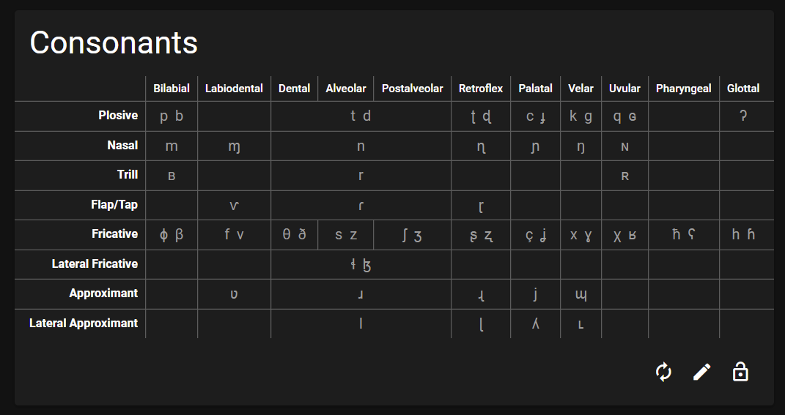
Proof Of Concept
Table of IPA consonants
Table of IPA vowels
Generate logical combinations of consonants and vowels
Generate spelling rules
Make IPA tables editable
Make spelling rules editable

Slide 9





Technology
Typescript
Programming language that compiles into Javascript
VueJS
A framework (similar to React) that adds data binding and other helpful UI features
Quasar
Adds a bunch of layout and UI components on top of VueJS
Pinia
Application state management library
Passport
Authentication library (may change)

Slide 10
Risks

Slide 11
Risk
Display IPA characters on the page
Mitigation
Already done, IPA characters are a part of Unicode and widely supported

Slide 12
Risk
Generate a logical phonology and phonotactics
Mitigation
Requires research. I already have acquired the book to help with the design

Slide 13
Risk
Displaying sample sentences utilizing the words and grammar of the language
Mitigation
Likely won’t be feasible and is more of a stretch goal. If I have time, I will have to look into this

Slide 14
Questions?

